Slide 1
Strategic Communications Planning
Session 4: Tactics
Instructors: Robert Hornsby
& Cassandra Nathan

Slide 2

Review of session 3 – Strategy:
How did it go?
What was easiest piece to define or explain?
What was the hardest piece to define or explain?

Slide 3

Refresher: Elements of a Communications Plan
Situation Analysis
Goals – the WHY
Strategy – the WHAT
Tactics – the HOW
Metrics
Evaluation

Slide 4
Understanding Tactics:
Tactics are the platforms for delivery of content.
In other words, tactics are your toolkit.
Content is what you produce, a.k.a. “a deliverable.”
Audiences are the recipients, the users or consumers of content.
Engagement is an action prompted by content.
Effective tactics need:
Target audience(s) – who will receive/participate
Delivery system(s) – the medium(s)
Demonstrable product – the content/news/story itself
Timelines – when to deliver product

Slide 5
Tactics & Story: Not the same things.
Tactics = The method(s) you use to present or deliver your content.
Story = The substance or subject of your content.
Note: A single story could be presented across with multiple platforms. For example, you could have a webpage post, a podcast, and a photo gallery about the same story.
To clarify with an example:
Publishing a series of podcasts is a tactic.
The podcast itself is the content.

Slide 6
About Tactics & Audiences:
The demographics of audiences are varied by platform.
Audiences are now fragmented/segmented and have fewer common platforms
(e.g. Liberals watch MSNBC; older White Republicans watch FOX TV News)
Consider how receptive your audiences may be to your message/tactic, i.e. – audience sentiment/reaction:
Supporters/loyalists
Ambivalent/uninformed
Skeptics/“non-receptive”
Note: For Metrics & Evaluation, think about how you will gather data and judge success of your tactics and messaging.

Slide 7
About Content:
Just publishing any information or creating deliverables is not enough to create engagement. Content has to be more than filler to be effective.
Good vs. Great content:
Good content is merely informative, it says, in effect, “This thing happened.”

Slide 8
About Content:
Just publishing any information or creating deliverables is not enough to create engagement. Content has to be more than filler to be effective.
Good vs. Great content:
Good content is merely informative, it says, in effect, “This thing happened.”
Great content has:
  Emotional appeal
  Demonstrates impact, effect
  Embodies your key messages
  Revelatory, provocative, or surprising
  Connects to a person
  What else?

Slide 9
Tactics class exercise – Name some of the mediums or formats of communications:

Slide 10
Tactics class exercise – Name some of the mediums or formats of communications:
Owned media – your webpage, newsletters, magazine, emails -- produced by you, distributed by you.
Earned media – news articles, opinion editorials – “placed” by you; often produced by others (but not always).
Paid media – advertising, advertorials – produced by you; you pay a platform to distribute.
Social media – posts on Facebook, Twitter, Instagram, LinkedIn
Audio media – Podcasts, audio chat
Video media – YouTube, Vimeo
Physical media, a.k.a. print collateral – booklets, annual reports, posters, flyers
Experiential media – events, lectures, panels, conferences
Other?

Slide 11
About Tactics: What is News, and what gives an idea “news value?”
Name some typical newsworthy subjects or types of content with inherent news value.

Slide 12
About Tactics: What is News, and what gives an idea “news value?”
Name some typical newsworthy subjects or types of content with inherent news value.
Analysis connected to topics of the day
Genuine academic or technology breakthroughs
Startling observations or opinions
New reports, studies, metrics
New products, services, new opportunities
New hires
Calendar-driven timing (elections, holidays, Valentines Day, etc.)

Slide 13
About Storytelling: Five elements to consider about storytelling:
News value – Why is this item “news”; what are the elements that give it news value?
Audience – Who will or should care about your story? How valuable are they to your program? How will you reach them?
Author – Is that you or someone else, like a freelancer or an external journalist?
Imperative – What or who is motivating the story? An important occurrence or event, a departmental mandate, or a directive from some higher authority?
Time & resources – how much of your time will it take to produce this content, and will there be other expenses, such as photography?

Slide 14
About Storytelling: Five elements to consider about storytelling:
News value – Why is this item “news”; what are the elements that give it news value?
Audience – Who will or should care about your story? How valuable are they to your program? How will you reach them?
Author – Is that you or someone else, like a freelancer or an external journalist?
Imperative – What or who is motivating the story? An important occurrence or event, a departmental mandate, or a directive from some higher authority?
Time & resources – how much of your time will it take to produce this content, and will there be other expenses, such as photography?
Exercise: Pick any item among your tactic mix. Rate it 1-5 for each of the above (5 is best). Average the score. Is it still worth producing this content if it has a 2.0 average score?

Slide 15
More about Storytelling:
Great content has context – a place, people, drama – that give it meaning or value.
Context is about telling a story.
Attributes of good storytelling:
Put a person into the story – a profile or story told through their eyes/experience
Show the impact of how your news/issue affects a person(s)
Explain causation or history
Use analogy to make news relatable to a more common experience
Make it visual – photos, graphics & video now more important than ever
Other?

Slide 16
About Campaigns:
Campaigns = An organized collection of tactics, usually around same content, theme or subject
often sequential tactics over time.
Study question: How/why do campaigns work?
Audiences benefit from multiple “touchpoints,” i.e. sequential/repeated communications
Attributes of campaigns, they:
  Service themes by unpacking linked concepts.
  Repeat and reinforce key messages in different formats/platforms.
  Help to move audience from information to action (conversion).

Slide 17
Tactical tips:
Good tactics from your audit/situation analysis can be repeated – just make sure you review and refresh the content so that it’s timely.
But be wary of tactics that are “we’ve always done it this way…” – be certain a previous tactic has worked before cloning it into your plan.
Involve journalists in events. They are great as moderators and panelists, and bring not only their professional expertise and insight about subjects, but they also have a readymade audience.

Slide 18
Tactics – Study questions:
Is the tactic mission-congruent with your Comms goals?
Is the content compelling?
  Does the subject/story have an emotional or intellectual “hook”?
  Is it timely, concerned with topics of the day?
  Does is have urgency or is it deadline-driven?
What is the “call to action” in your messaging?
  Is that clear?
  Is it truly persuasive?
How does a given tactic create engagement?
How do you want audiences to respond to your content?

Slide 19
Breakout session:
“Situation of the Day”: Your word-processing application has crashed today, but you are under deadline pressure, so you must design some content without written words.
For a story about the impact of climate change on one of your unit’s target audiences, what images, graphics, videos or audio would you need?
Go.

Slide 20
Homework:
Make substantive comments on Master plan documents and especially about Strategies by your teammates.
Insert 1-page (minimum) Tactics into your Master plan -- due next Thursday
Review files in Tactics folders – Google & LabArchives

Slide 21
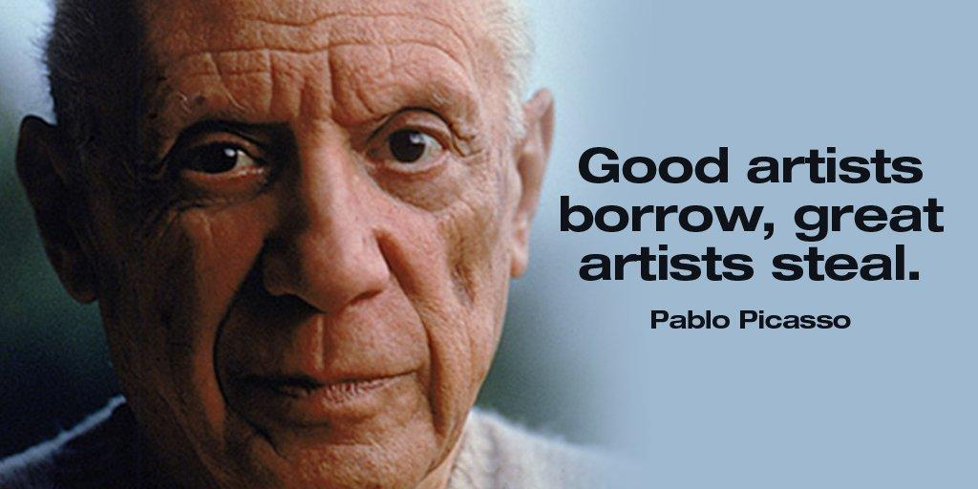
Homework:
Make substantive comments on Master plan documents and especially about Strategies by your teammates.
Insert 1-page (minimum) Tactics into your Master plan -- due next Thursday
Review files in Tactics folders – Google & LabArchives
Theft of ideas is not only allowed,
it’s encouraged!

